Slide 1
Green Propellant Thrust Stand
Team 517
Jeffrey Hill, Aidan Hoolihan, Ryan Kaczmarczyk,
Nicholas Jensen, Edward Zapert
02/20/2025

Slide 2
Team Sponsors & Advisors
Aidan Hoolihan
Marshall Space Flight Center
Sponsors:
Advisors:
Ebony Bland
Aerospace Engineer
Nicole Vaughn
Liquid Propulsion Engineer
Alexandre Berger, Ph.D.
Assistant Professor
Shayne McConomy, Ph.D.
Professor

Slide 3
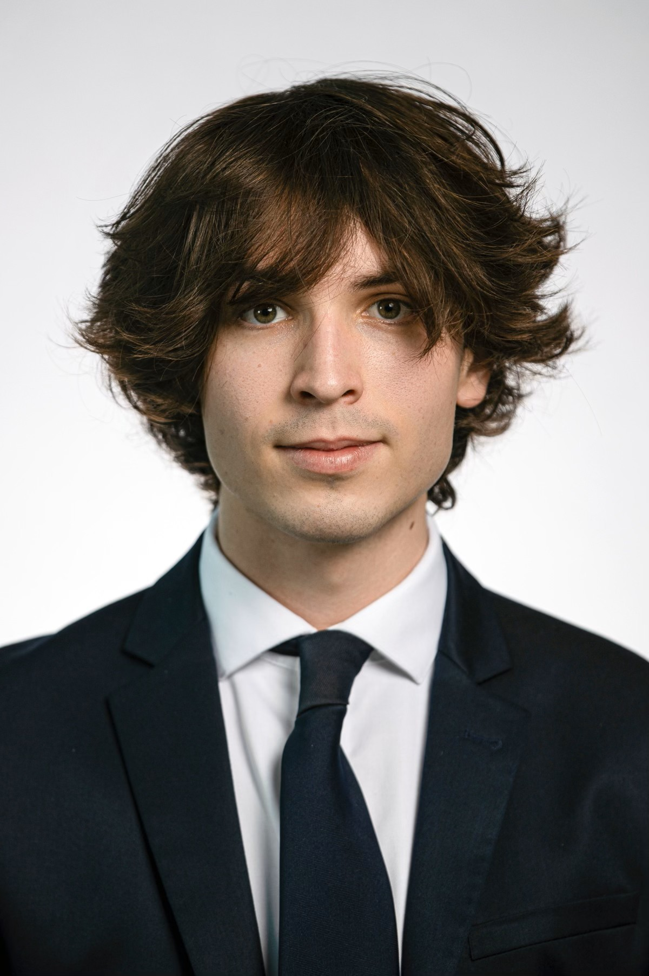
Team Introductions
Aidan Hoolihan
Jeffrey Hill
Thermal Fluids Engineer
Nicholas Jensen
Manufacturing Engineer
Edward Zapert
Design Engineer
Aidan Hoolihan
Materials Engineer
Presenter
Ryan Kaczmarczyk
Controls Engineer
Presenter
Presenter

Slide 4
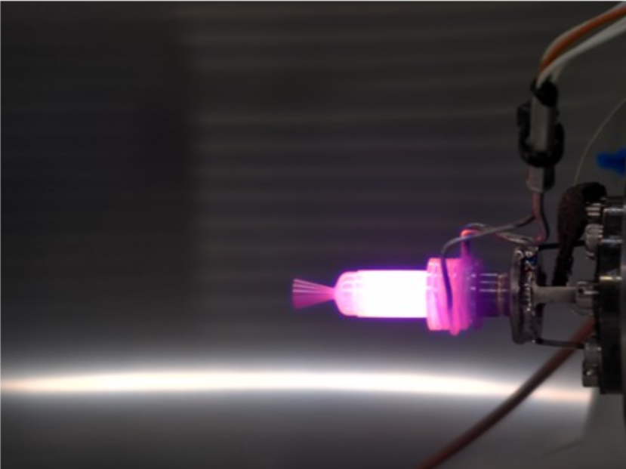
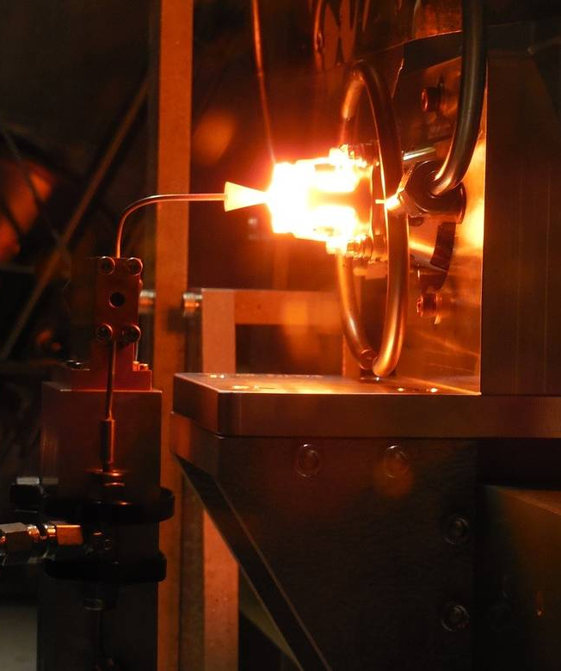
Objective
Aidan Hoolihan
The objective of this project is to develop a thrust stand that can take accurate measurements of a 0.1N green propellant thruster.

Slide 5
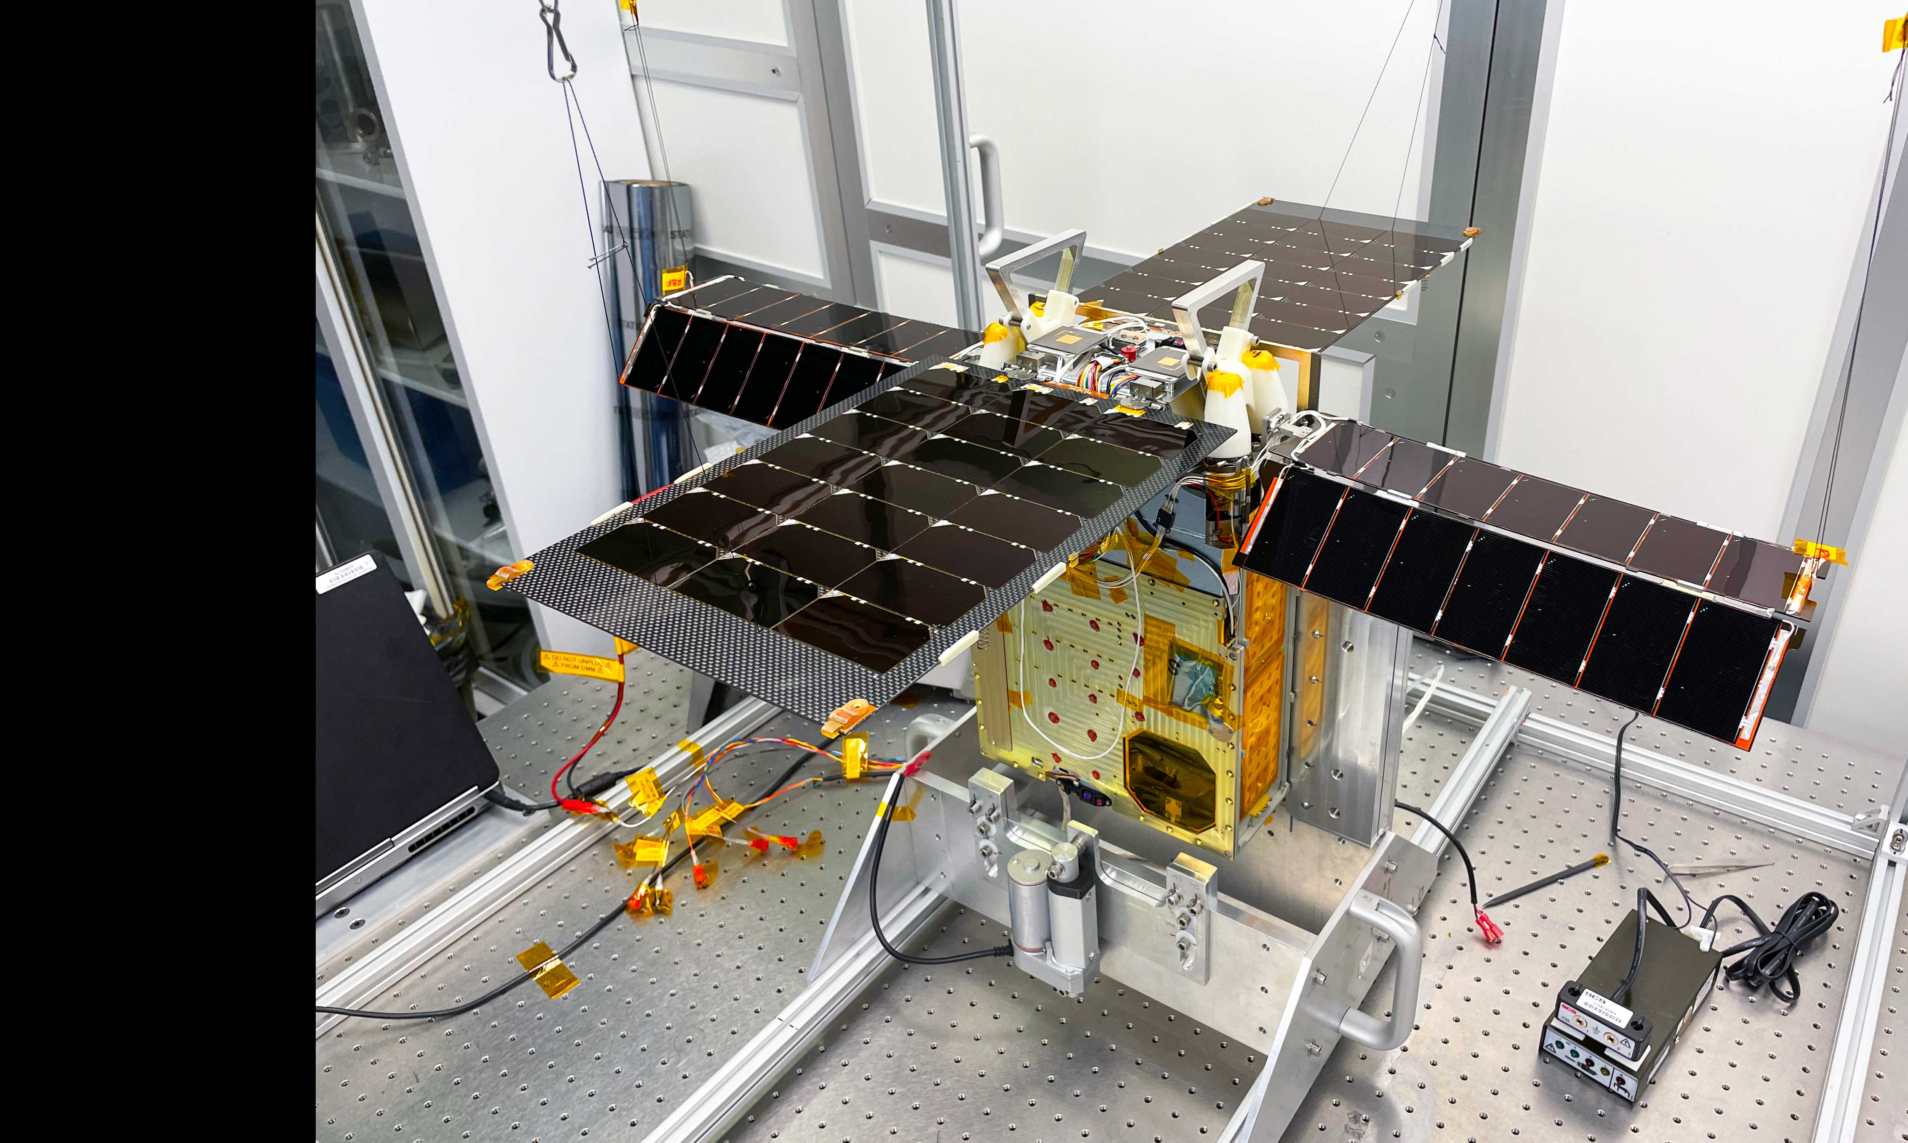
Project Background
Aidan Hoolihan
Green Propellant
Current Uses
GPIM Tech demonstration Mission
Cheaper and safer than hydrazine
Requires less fuel onboard
Lunar Flashlight CubeSat mission to map ice on the moon
Notes:
new alternative to typical rocket fuel SA hydrazine
Of interest because it is cheaper and safer than what is currently used
This new propellant has only been part of a few missions those being:
Lunar south pole

Slide 6
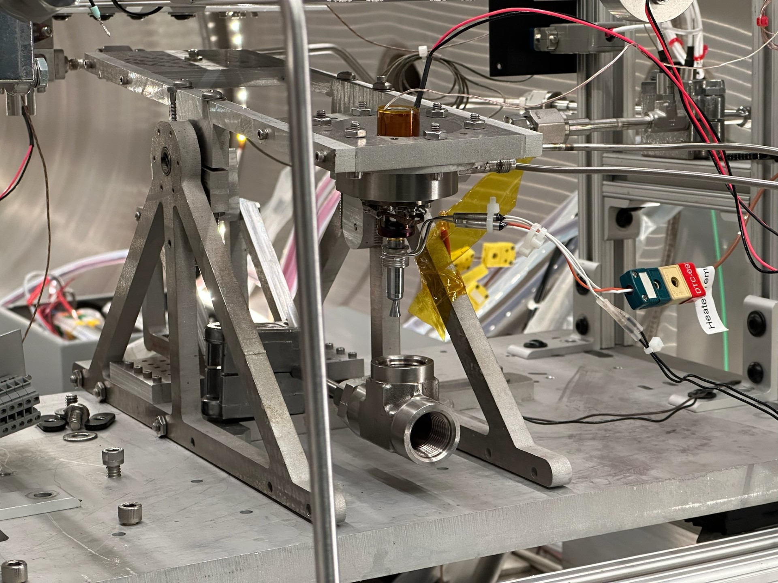
What Makes a Good Thrust Stand?
Aidan Hoolihan
To answer this question lets first look at an example:
Pictured on the right is what NASA-MSFC currently uses for micro thrust measurement
Thrust stand is fired in vacuum
The 0.1N thruster collects data that is small and easily skewed
Thruster pushes upward to rotate see-saw, pushing into force sensor
Wires/piping through stand power sensors and provide propellant
Flame bucket diverts heat away from stand
Current stand is made of aluminum
Notes:
To achieve our objective, we first took a look at what is currently used by the folks at MSFC

Slide 7
What Makes a Good Thrust Stand?
Aidan Hoolihan
What does this tell us about our sponsors needs?
NASA-MSFC
Gathered Insights
Meetings
Lab Visit
Improvement Areas
Refined Details
Defined Needs
Notes:
It took many meetings and even a visit to the NASA-MSFC laboratory in Huntsville Alabama for Team 517 to learn these details about the current thrust stand
After more communication with sponsors, Team 517 learned that not all these characteristics are positive, and others have significant room for improvement
The next task was interpreting our conversations to lay out groundwork for our customers needs
This involved many team meetings, along with many zoom calls with our sponsors to iron out details of the design

Slide 8
What Makes a Good Thrust Stand?
Aidan Hoolihan
Team 517’s Interpreted Needs
Design must be able to take measurements of a micro thruster
Pictured previously is what NASA-MSFC currently uses for micro thrust measurement
Thrust stand is fired in vacuum
The 0.1N thruster collects data that is small and easily skewed
Thruster pushes upward to rotate see-saw, pushing into force sensor
Wires/piping through stand power sensors and provide propellant
Flame bucket diverts heat away from stand
Current stand is made of aluminum
Thrust stand must be capable of enduring and functioning in a high vacuum environment, where it cannot be reached by users
Collected data must be precise, and account for environmental and computational error to ensure precision
If a see-saw mechanism is used, it must be able to lock to prevent unwanted movement during transport
Thrust stand should have good wire management and spacious enough to include the propellant piping
Design must have a mechanism that diverts heat to an empty region of the vacuum
Aluminum is a material concern due to corrosion; another material must be selected for the design that is non-corrosive

Slide 9
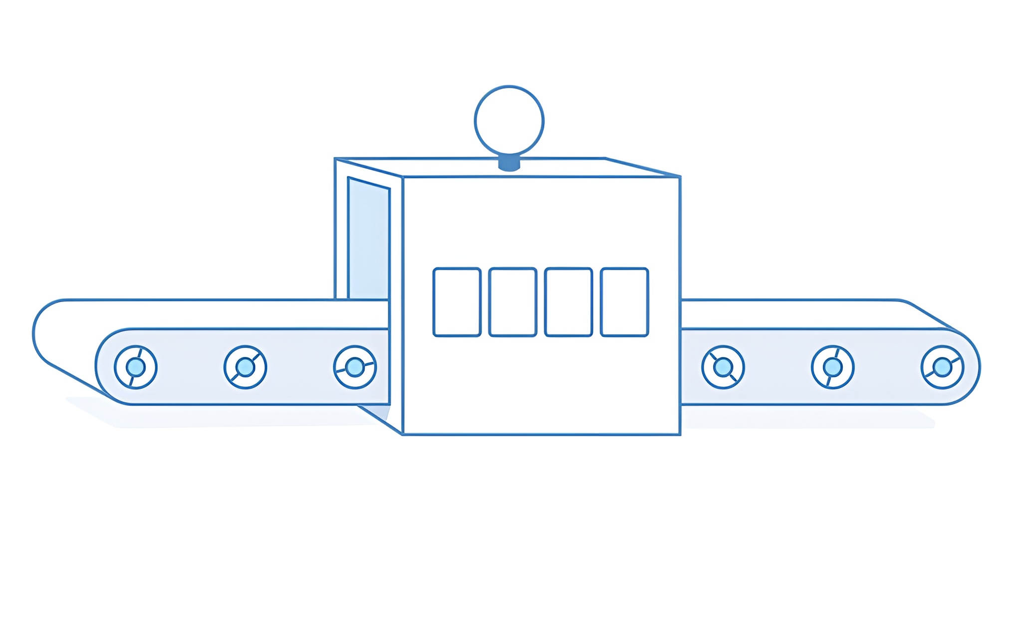
Design Process: Ideation
Aidan Hoolihan
Key Features
Ideas
Precise measurement
Calibrates Remotely
Error calculation
Easy to clean
Locking mechanism
Lightweight
No larger than 12x18 in
non-corrosive material
Key characteristics for the thrust stand were identified through ideation and selection.
Methods used: Binary Pairwise, Pugh Charts, and House of Quality.
The process helped determine essential vs. flexible features.
Key features shaped the original design and its iterations.

Slide 10
Design Iteration #1
Nicholas Jensen
Pros
Cons
Low resonant frequency
Low cost
Easy to clean
High visibility
Moment induced on linkage
Unrealistic proportions
Minimalistic
Flame Bucket
Calibration Mechanism
Vibrational Damping
Terminal Blocks

Slide 11
Design Iteration #2
Nicholas Jensen
Pros
High resonant frequency
Cons
Hard to manufacture
Calibration setup with heavy linkage
Modular
Low visibility
No link pivot integration
Limited room near thruster to work
Sensor Mount
Thruster Linkage Mount
Structural Components
Calibration Linkage
Calibration Weight Module

Slide 12
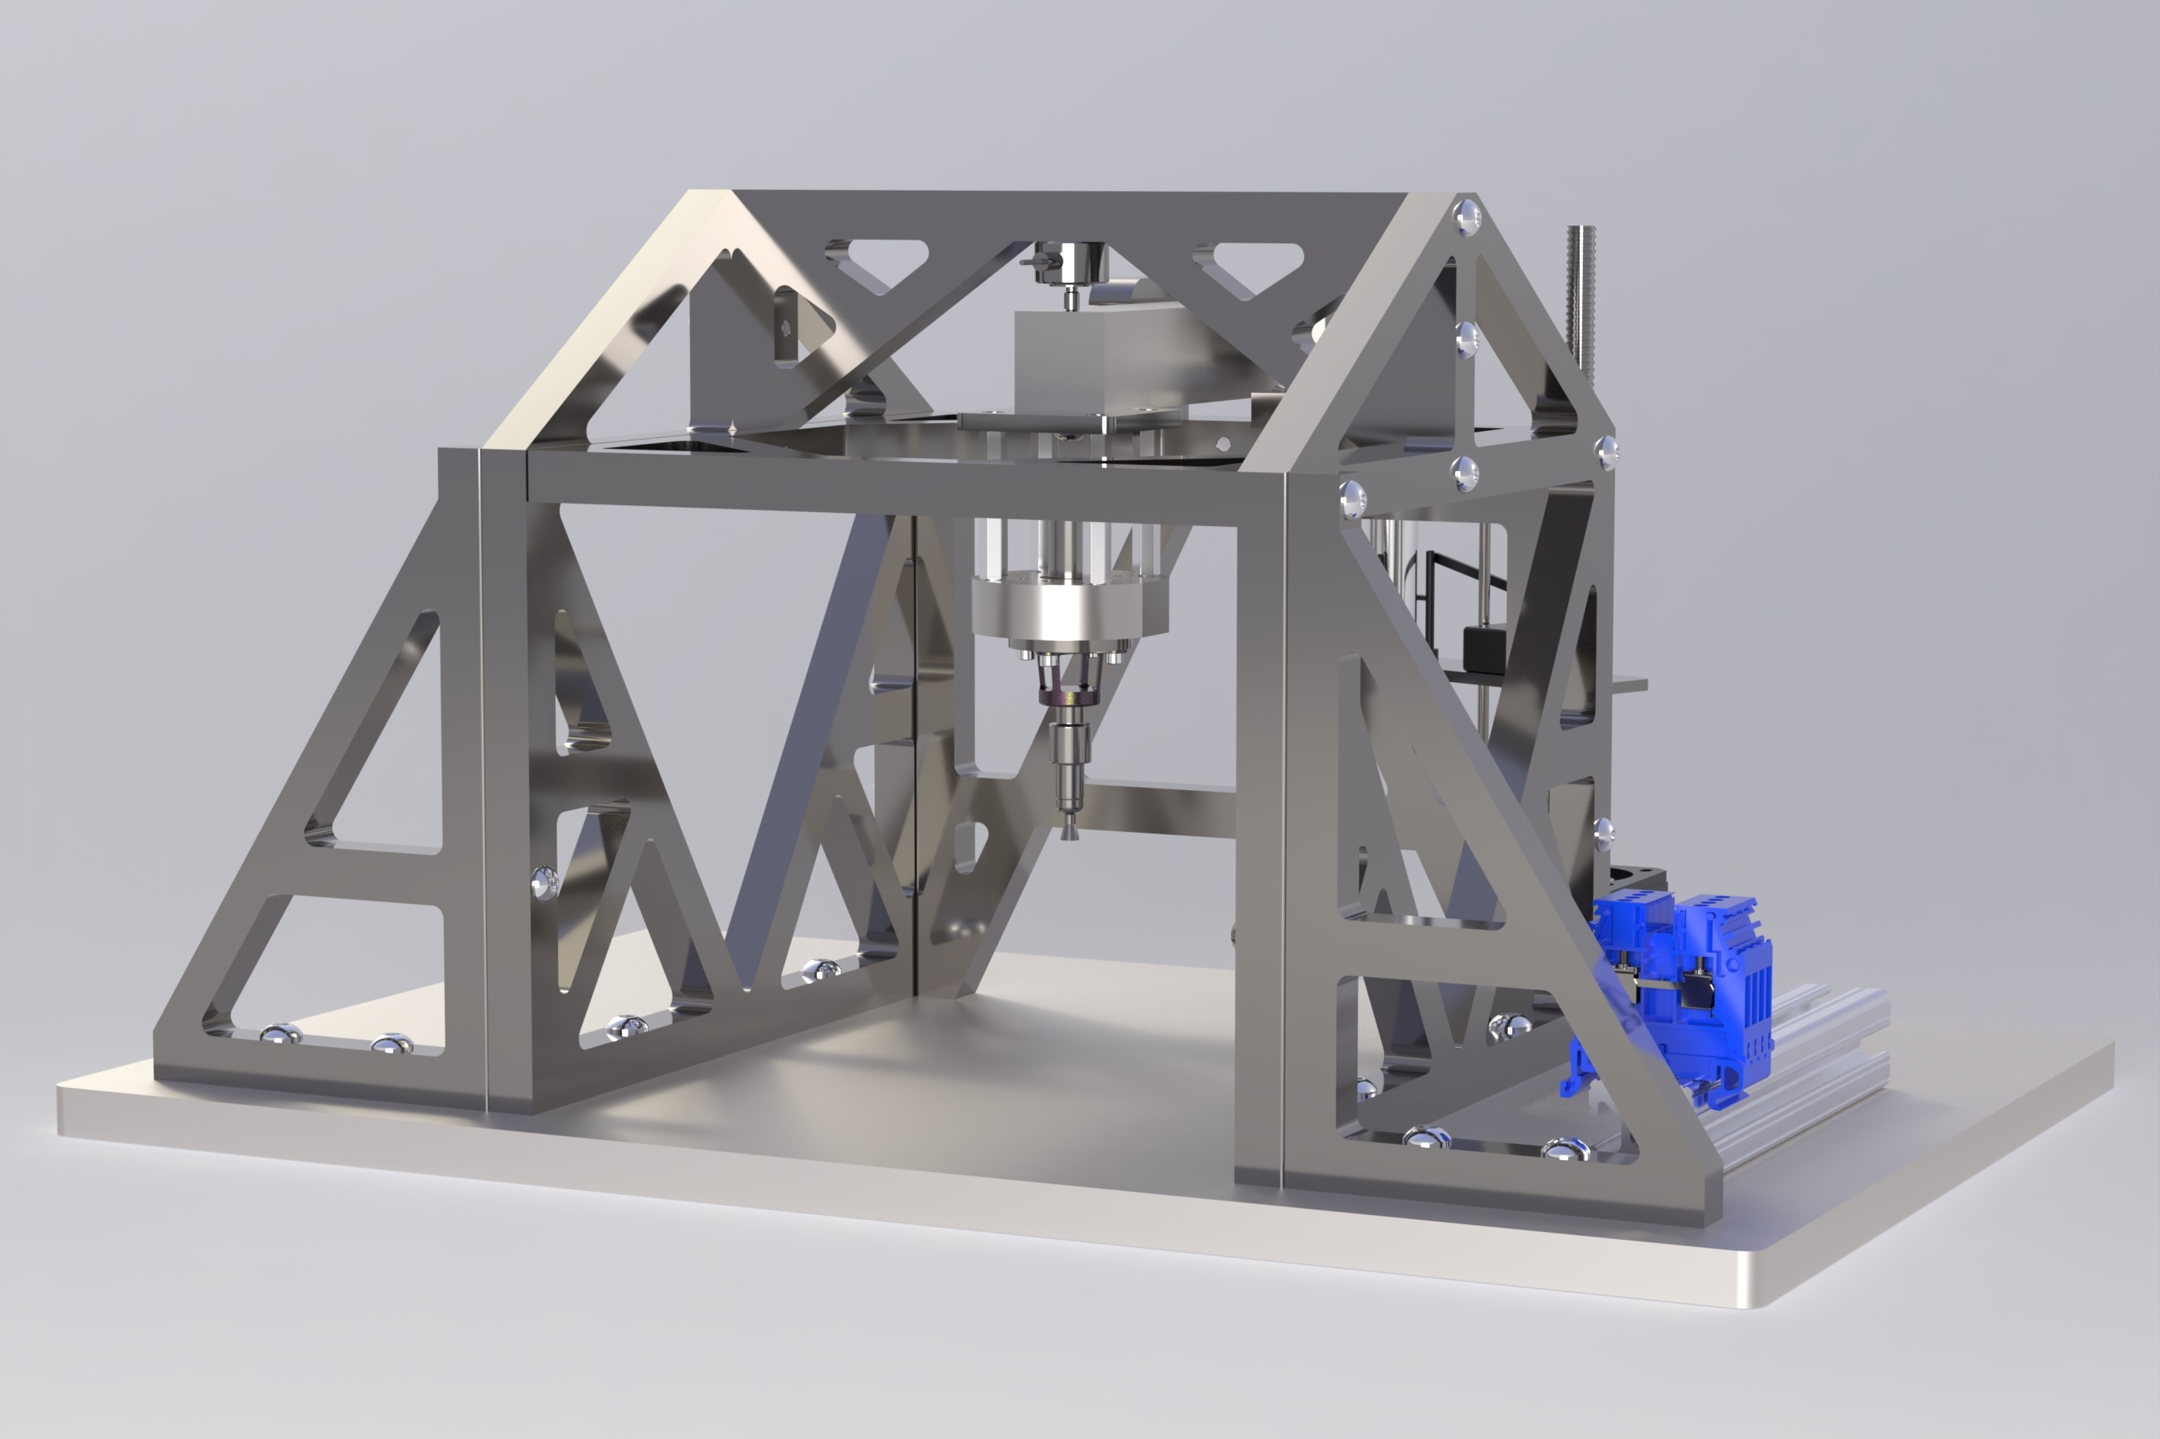
Final Design
Nicholas Jensen
Updates
Redesigned structure
Thruster
Calibration weight
Bearings
Improved calibration method
Interchangeable sensor mounts
Bolt design
Machinability
Optimized mounts

Slide 13
Final Design
Nicholas Jensen
Thruster Link Mount
Thruster Block
Solenoid Valve
Thruster

Slide 14
Final Design
Nicholas Jensen
Bearing Mount
Preload Weight
Calibration Weight Hook
WIKA Force Sensor

Slide 15
Final Design
Nicholas Jensen
Modular Terminal Blocks
Calibration Weight
Stepper Motor Calibration Lift

Slide 16
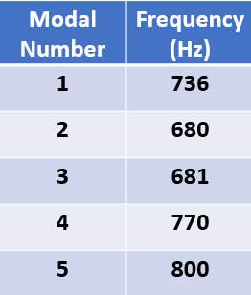
Design Validation: Modal Analysis
Edward Zapert
Design Goal: Create stand with resonant frequencies around 700Hz
Final Results
Run Modal Analysis
Once
f ≈ 700 Hz
Initial Design
$\sqrt{\frac{k}{m}}$

Slide 17
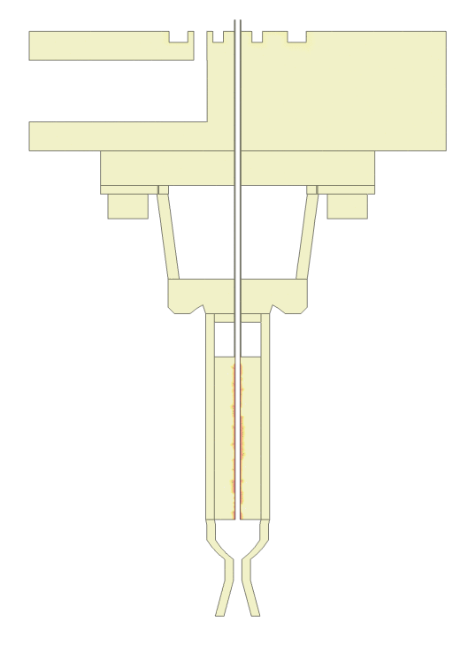
Design Validation: Thermal Analysis
Edward Zapert
Design Goal: Model heat transfer from thruster to validate sensor placement
Dual Heat Sources
Thruster and Solenoid
30 Second Steady Thruster Fire
Key
- Tungsten Core
- Rhenium Body
Results after 30 seconds
- Titanium Mount
- 304 S.S. Block
Maximum Contact Temp of 20ºC

Slide 18
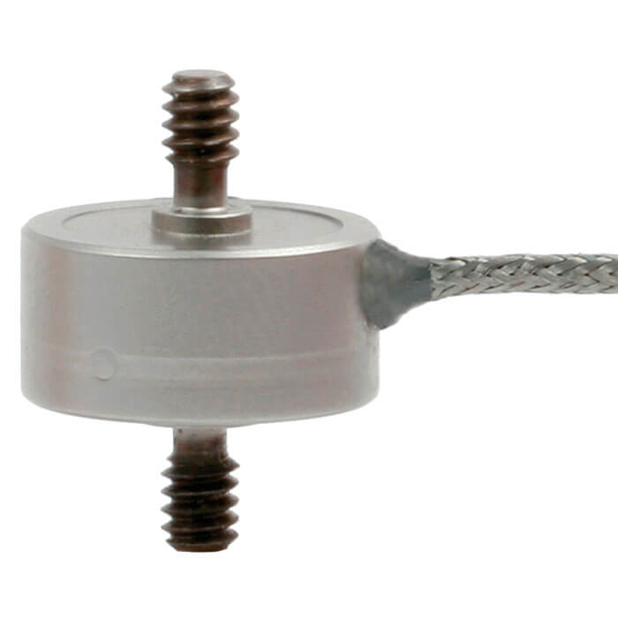
Current Budget
Edward Zapert
FAMU-FSU Engineering
Supplied by Sponsor
WIKA Model F2221 Force Transducer ($1500)

Slide 19
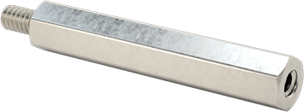
Current Expenses
Edward Zapert
Raw Material
Hardware
Bearings
304 Stainless Steel Plating
Screws, Hooks, Standoffs
Ceramic Bearings
$493.49
$68.07
$105.24

Slide 20
Future Work
Edward Zapert
Machining and Assembly
Sensor Testing
Documentation
Test WIKA sensor using 3D printed test equipment
Send purchased parts to machine shop and assemble final stand
Create CAD drawings and begin assembly manual

Slide 21
Future Work: Roadblocks
Edward Zapert
Potential budget issues with next trip to NASA-MSFC in Huntsville
Machining times
Error analysis coding
Trial and error needed to process sensor data and filter noise.
Debugging the uncertainty model may delay accurate thrust validation.

Slide 22
Quick Recap
Edward Zapert
Background
Green propellant is safer and more efficient than hydrazine
Design Validation
Modal analysis ran to verify natural frequency
Accurately measure the thrust of a 0.1N green propellant thruster
Key Goals
Minimize uncertainty
Remotely calibrate under vacuum
Thermal analysis ran to verify temperature output near sensor
Vacuum Conditions
Remote Calibration
ASCENT
NASA MSFC
FAMU-FSU COE

Slide 23
Slide Headline
Try to keep text at 16 pt minimum.
Try to put as few words as possible on the slide if you’re using for a presentation.
Mix and match the backgrounds as shown in this template or just use one throughout.
You can put department/unit logos in slide master at Horizontal 0.89” Vertical 6.44” From top left corner

Slide 24
Font Check
This is 10-point
This is 15–point Times
This is 20–point
This is 25–point
This is 30–point
This is 35–point
This is 40–point
This is 50–point
This is 60–point
This is 72–point
Notes:
Use at least 20-point font in Room A105, B134, and B136
Use at least 25-point font in Room B135

Slide 25
College of Engineering Color Palette
1 2 3 4
Pantone: PMS 195 C
RGB: 120, 47, 64
Hex: #782F40
CMYK:19, 90, 50, 55
1 2 3 4
Pantone: Black C
RGB: 0, 0, 0
Hex: #000000
CMYK:0, 0, 0, 100
Garnet
Black
1 2 3 4
RGB: 238, 118, 36
Hex: #EE7624
CMYK:2, 66, 99, 0
1 2 3 4
Pantone: PMS 000C
RGB: 255, 255, 255
Hex: #FFFFFF
CMYK: 0, 0, 0, 0
Fang
Orange
White
Notes:
Avoid 75% Black in B135

Slide 26
Accent Color Palette
1 2 3 4
RGB: 0, 59, 111
Hex: #003B6F
CMYK:
1 2 3 4
RGB: 0, 59, 111
Hex: #003B6F
CMYK:
1 2 3 4
RGB: 251, 236, 93
Hex: #FBEC5D
CMYK:
1 2 3 4
RGB: 219, 215, 210
Hex: #DBD7D2
CMYK:
1 2 3 4
RGB: 251, 236, 93
Hex: #FBEC5D
CMYK:
1 2 3 4
RGB: 219, 215, 210
Hex: #DBD7D2
CMYK:
Tardis Blue
Tardis Blue
Corn
Timberwolf
Corn
Timberwolf
1 2 3 4
RGB: 206, 0, 88
Hex: #CE0058
CMYK: 0, 100, 43, 12
1 2 3 4
RGB: 206, 0, 88
Hex: #CE0058
CMYK: 0, 100, 43, 12
1 2 3 4
RGB: 104, 40, 96
Hex: #682860
CMYK:
1 2 3 4
RGB: 220, 220, 220
Hex: #DCDCDC
CMYK:
Rubine Red
Rubine Red
Imperial
Gainsboro
1 2 3 4
RGB: 72, 146, 155
Hex: #48929b
CMYK:
1 2 3 4
RGB: 64, 224, 208
Hex: #40E0D0
CMYK:
1 2 3 4
RGB: 255, 139, 0
Hex: #FF8B00
CMYK:
Asagi-iro
Turquoise
American Orange
Notes:
Remove American orange add hyperlink grey
Make corn the last for b135
All work in 134 imperial move later
Tardis doesn’t work in b136

Slide 27
F7AB19
D67F15
EE7624
D64615
F73119
Analogous
6E3610
F0A16C
EE7624
6E4931
BASB1C
Monochromatic
A14508
4BED3B
EE7624
250CED
2010A1
Triad
A1470C
FF8C40
EE7624
0098A1
24E2ED
Complementary
28A164
2FED8D
EE7624
0848A1
1871ED
Split Complementary
EDAC2F
3BED93
EE7624
0C6AED
ED2F18
Double Split Complementary
ED660C
C7ED3B
EE7624
0CE1ED
A418ED
Square
BA7E09
87724A
EE7624
60EFCF
09BA61
Compound
https://color.adobe.com/create/color-wheel
AD551A
6E3610
EE7624
FA7625
D46820
Shades
Notes:
These are the variants that work well with Fang Orange. The bolded items show well on the projectors.

Slide 28
85412D
8F3831
782f40
8F3176
792D85
Analogous
C44D69
8E626D
782F40
C48796
451B25
Monochromatic
C43959
78743B
782F40
236178
43A2C4
Triad
C43959
C46078
782F40
25C43D
2F783A
Complementary
93C460
577835
782F40
39C49D
297861
Split Complementary
784435
5A783B
782F40
237860
6E2978
Double Split Complementary
782337
78683b
782F40
237830
293978
Square
AB4D32
DEBAAF
782F40
5D8555
70AB32
Compound
https://color.adobe.com/create/color-wheel
38161E
C44D69
782F40
853447
5E2532
Shades

Slide 29
A105
A105
B135 Stage Left
B135 Stage Right
B136
B134, A105
B135

Slide 30
Border Line
Border Line
Border Line
Center of White Space
Center of Slide
Middle of Slide
Middle of White Space
Edge of Branding
Border Line
Notes:
Vertical lines from top down.
Borderline and top of title. (0.5 inch)
Center of Slide (0 inch y-direction for the entire slide)
Center of Design Content (0 inch y-direction considering the title, footer, and negative space)
Bottom of Design Content (0.25 in gap to the footer. 0.75 to the bottom of the screen)
Horizontal lines from left to right
Borderline (0.5 inch)
Center of design content.
Center of slide (0 inch y-direction for the entire slide)
Borderline (0.125 inch all around)

